Slide 1
PGE 392K HW 1 Fall 2020
Grading Rubric
Slide Number | 2 | 3 | 4 | 5 | 6 | 7 | 8 | 9 | 10 | 11 | 12 | 13 | 14 | 15 | 16 | 17 | 18 | 19 | 20 | 21 | 22 | 23 | Total
Point | 4 | 4 | 4 | 4 | 4 | 4 | 4 | 4 | 4 | 4 | 5 | 5 | 5 | 5 | 5 | 5 | 5 | 5 | 5 | 5 | 5 | 5 | 100
Shadab, Mohammad Afzal

Slide 2
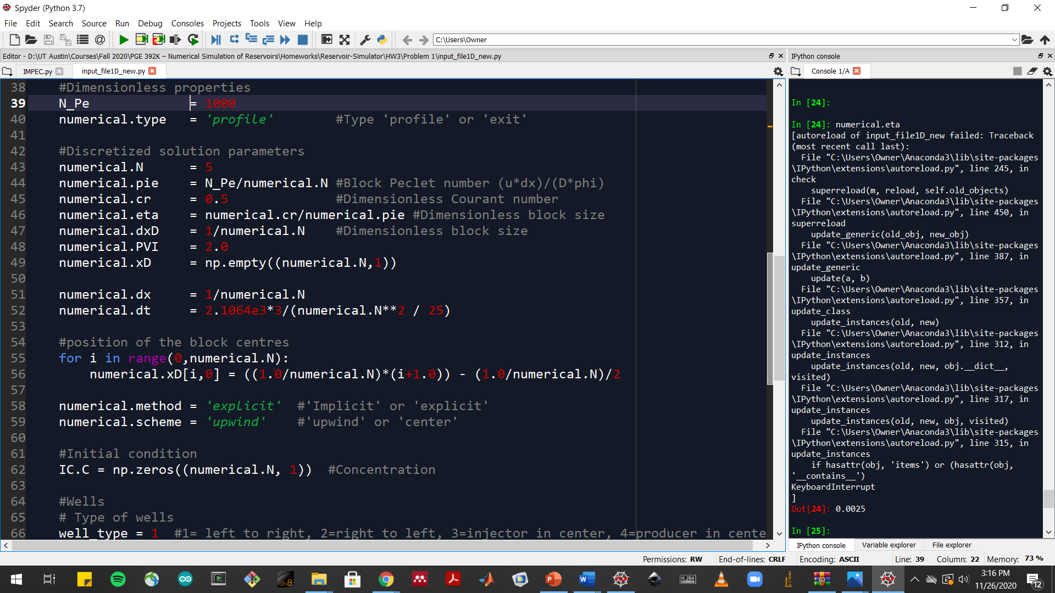
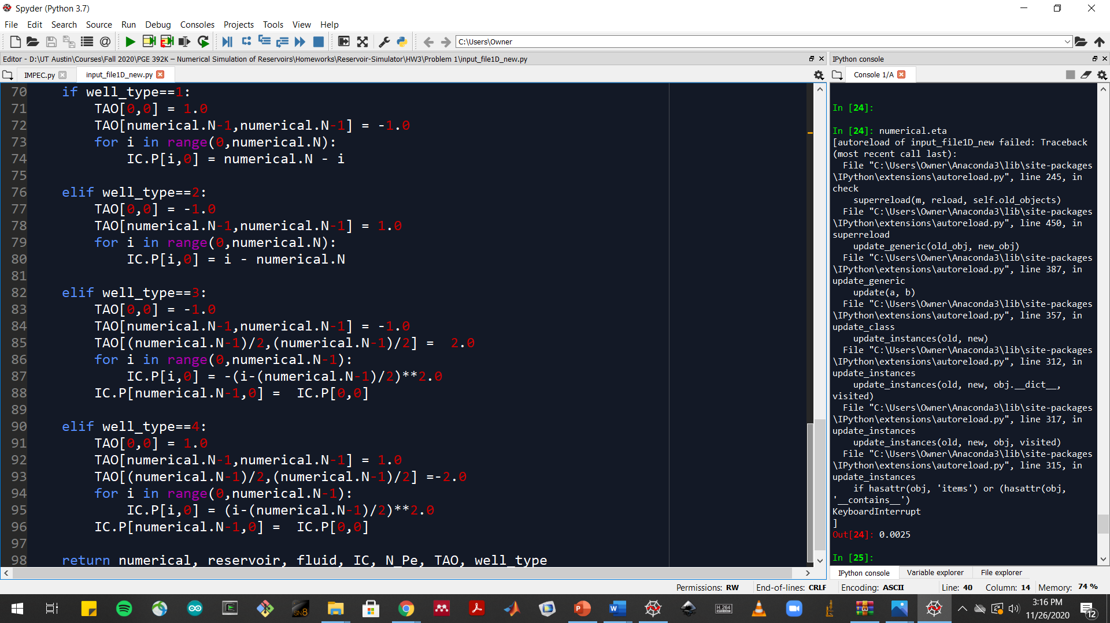
Problem 1.a.i Snapshot(s) of the code

Slide 3
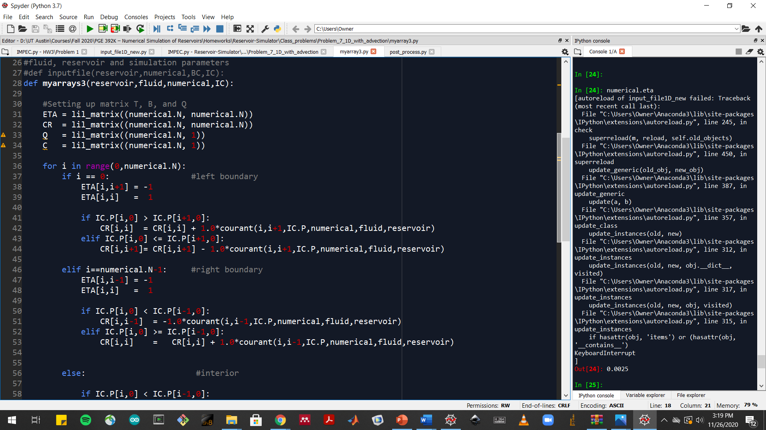
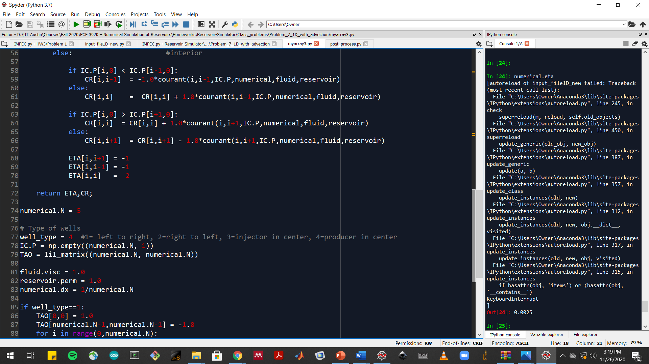
Problem 1.a.ii Snapshot(s) of the code

Slide 4
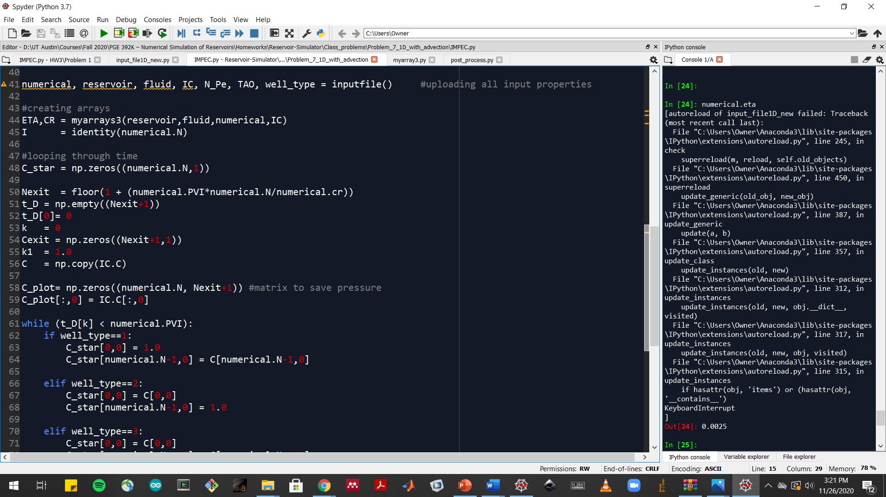
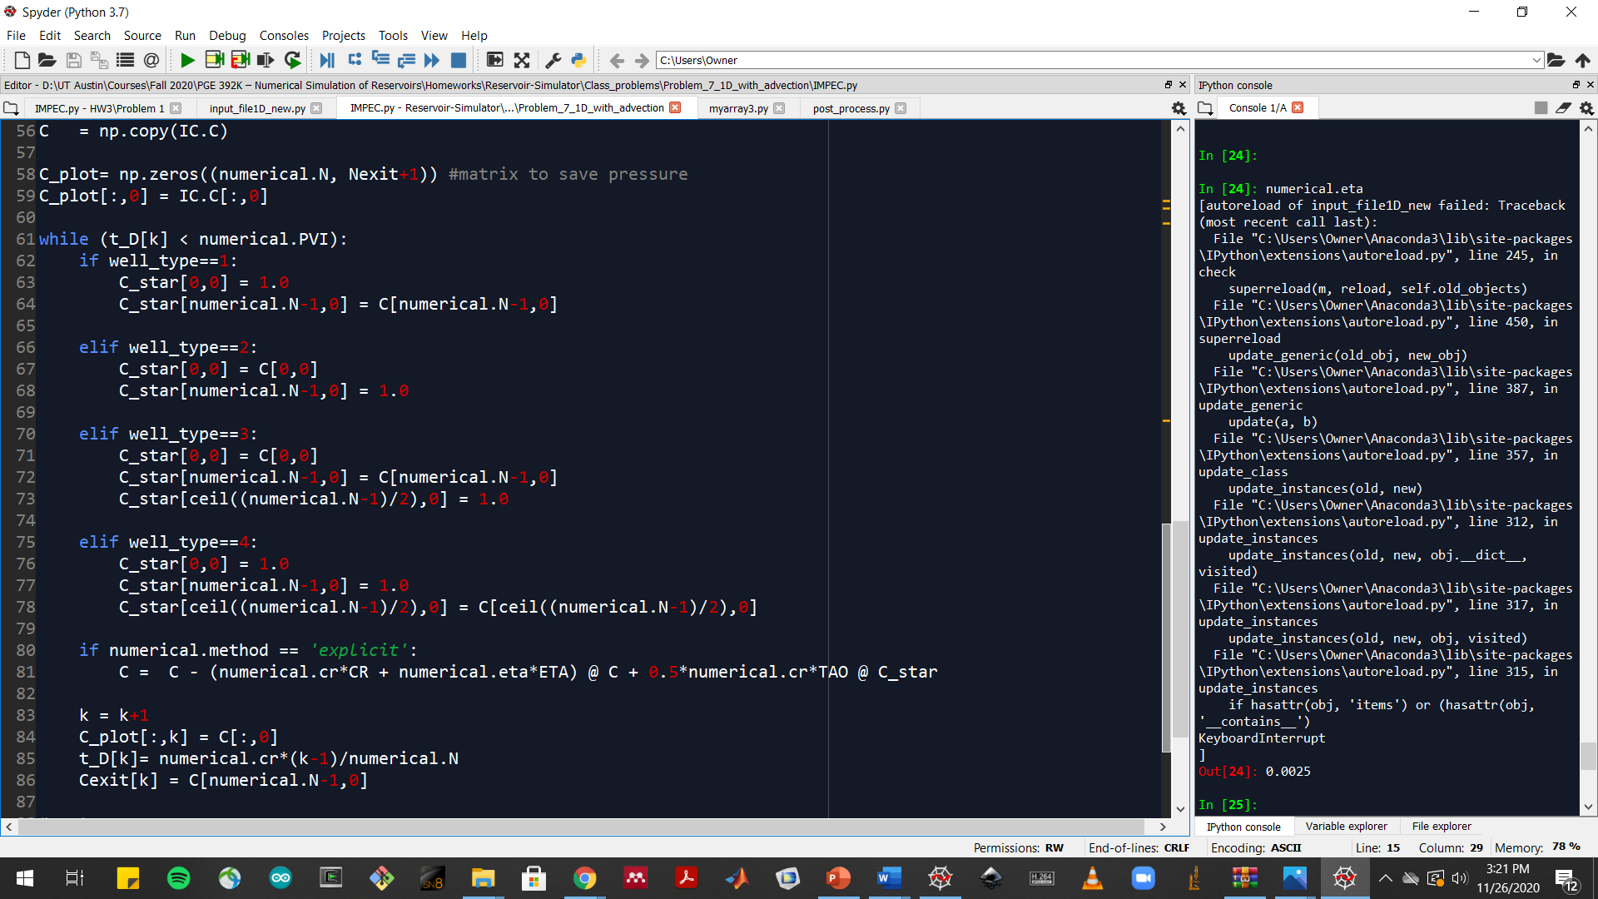
Problem 1.a.iii Snapshot(s) of the code

Slide 5
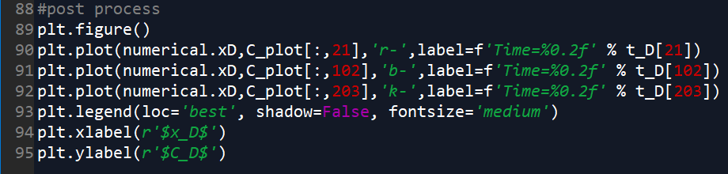
Problem 1.a.iv Plot

Slide 6
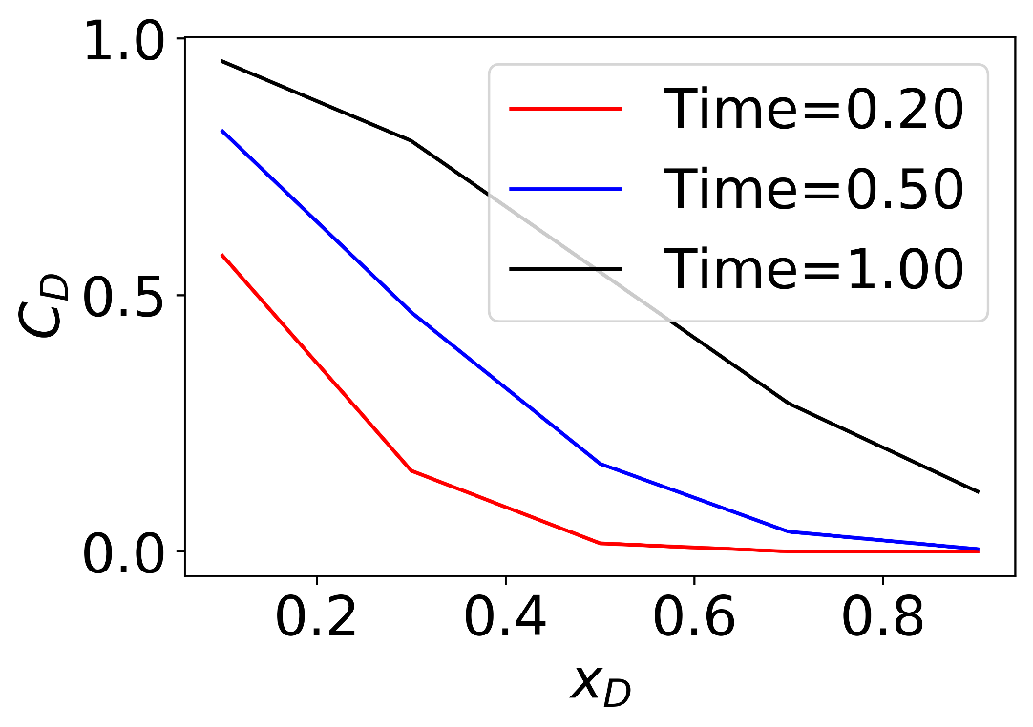
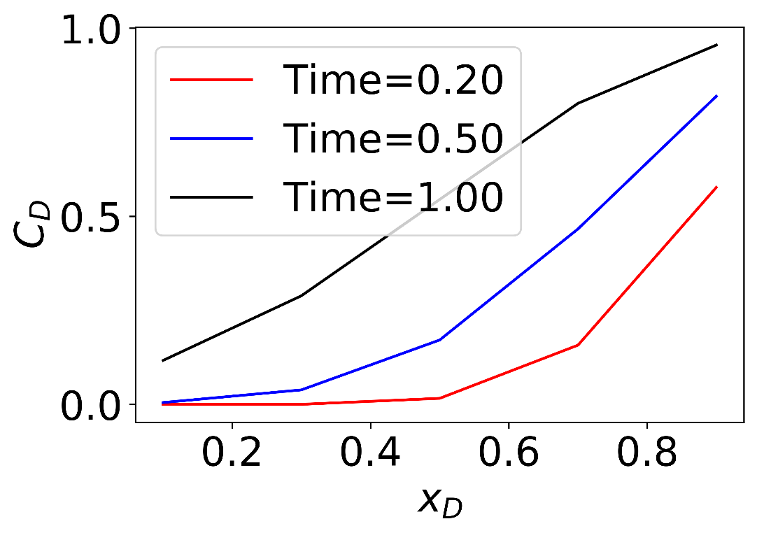
Problem 1.b Plots
Case 1
Case 2

Slide 7
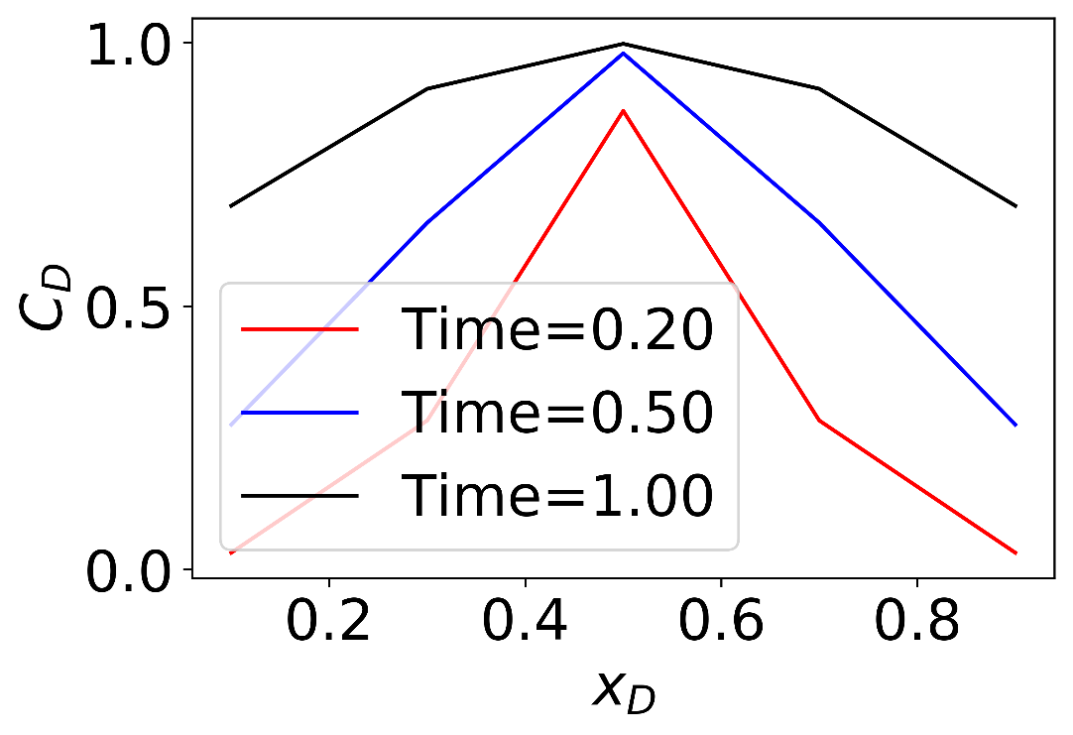
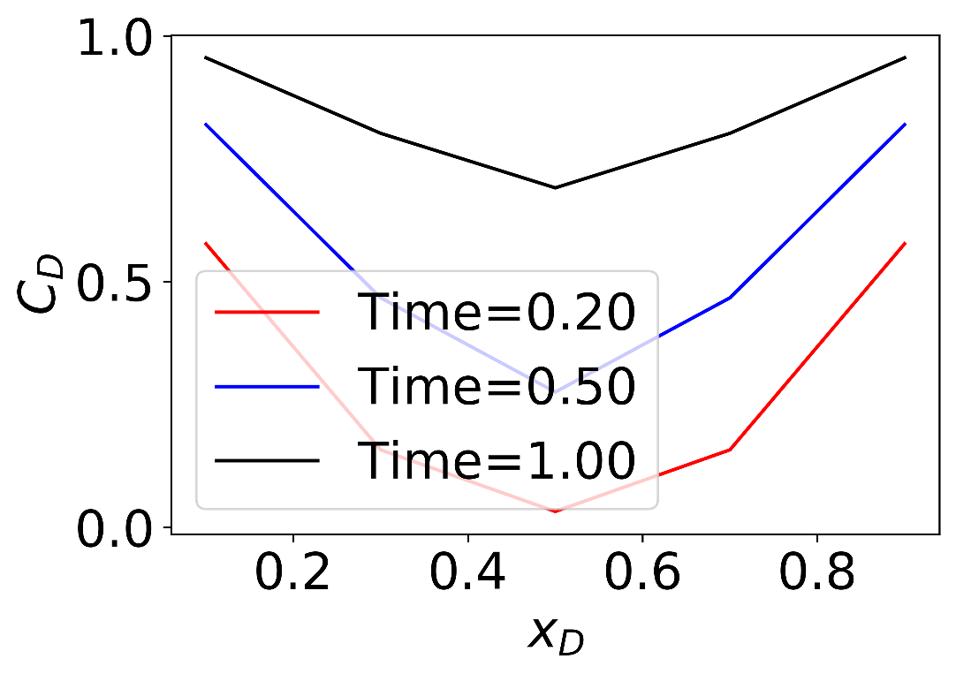
Problem 1.b Plots
Case 3
Case 4

Slide 8
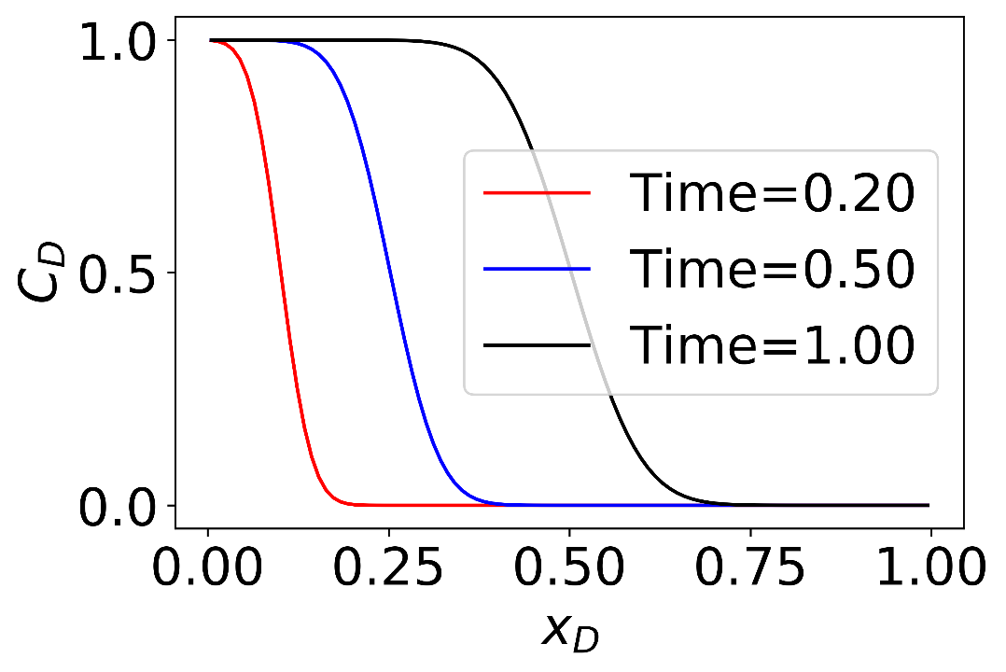
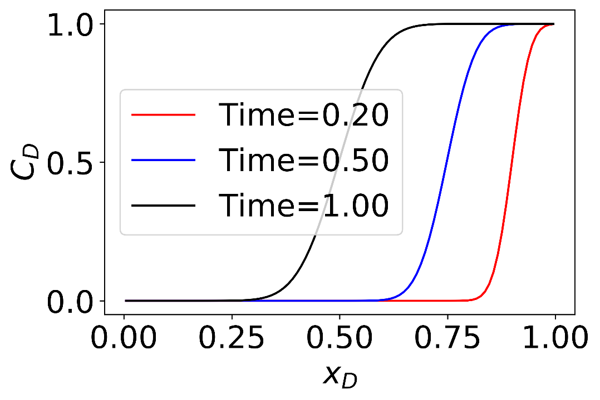
Problem 1.c Plots
Case 1
Case 2

Slide 9
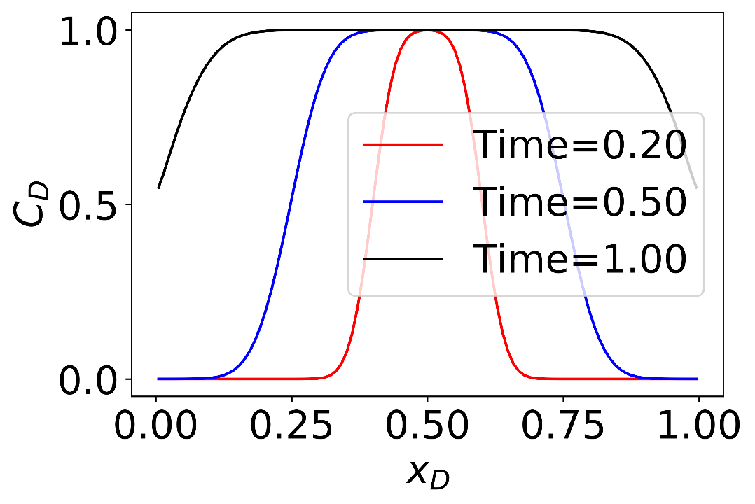
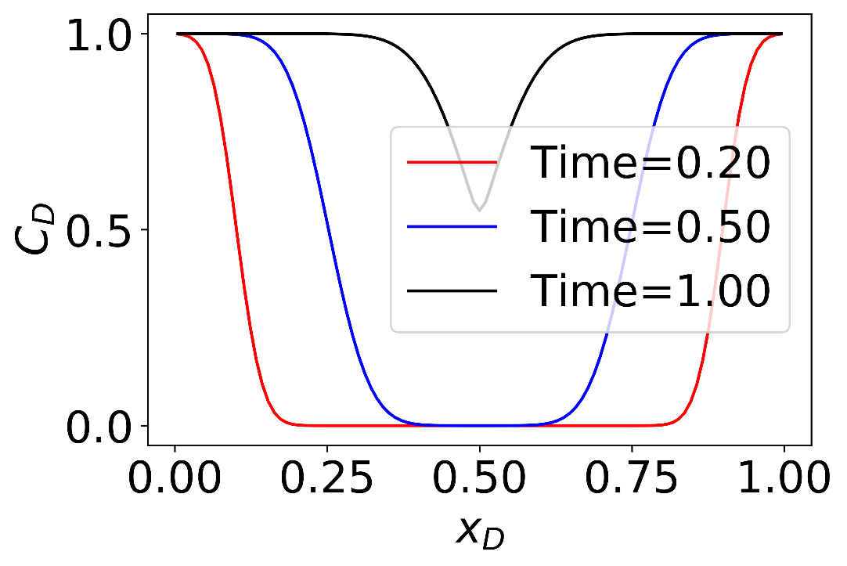
Problem 1.c Plots
Case 3
Case 4

Slide 10
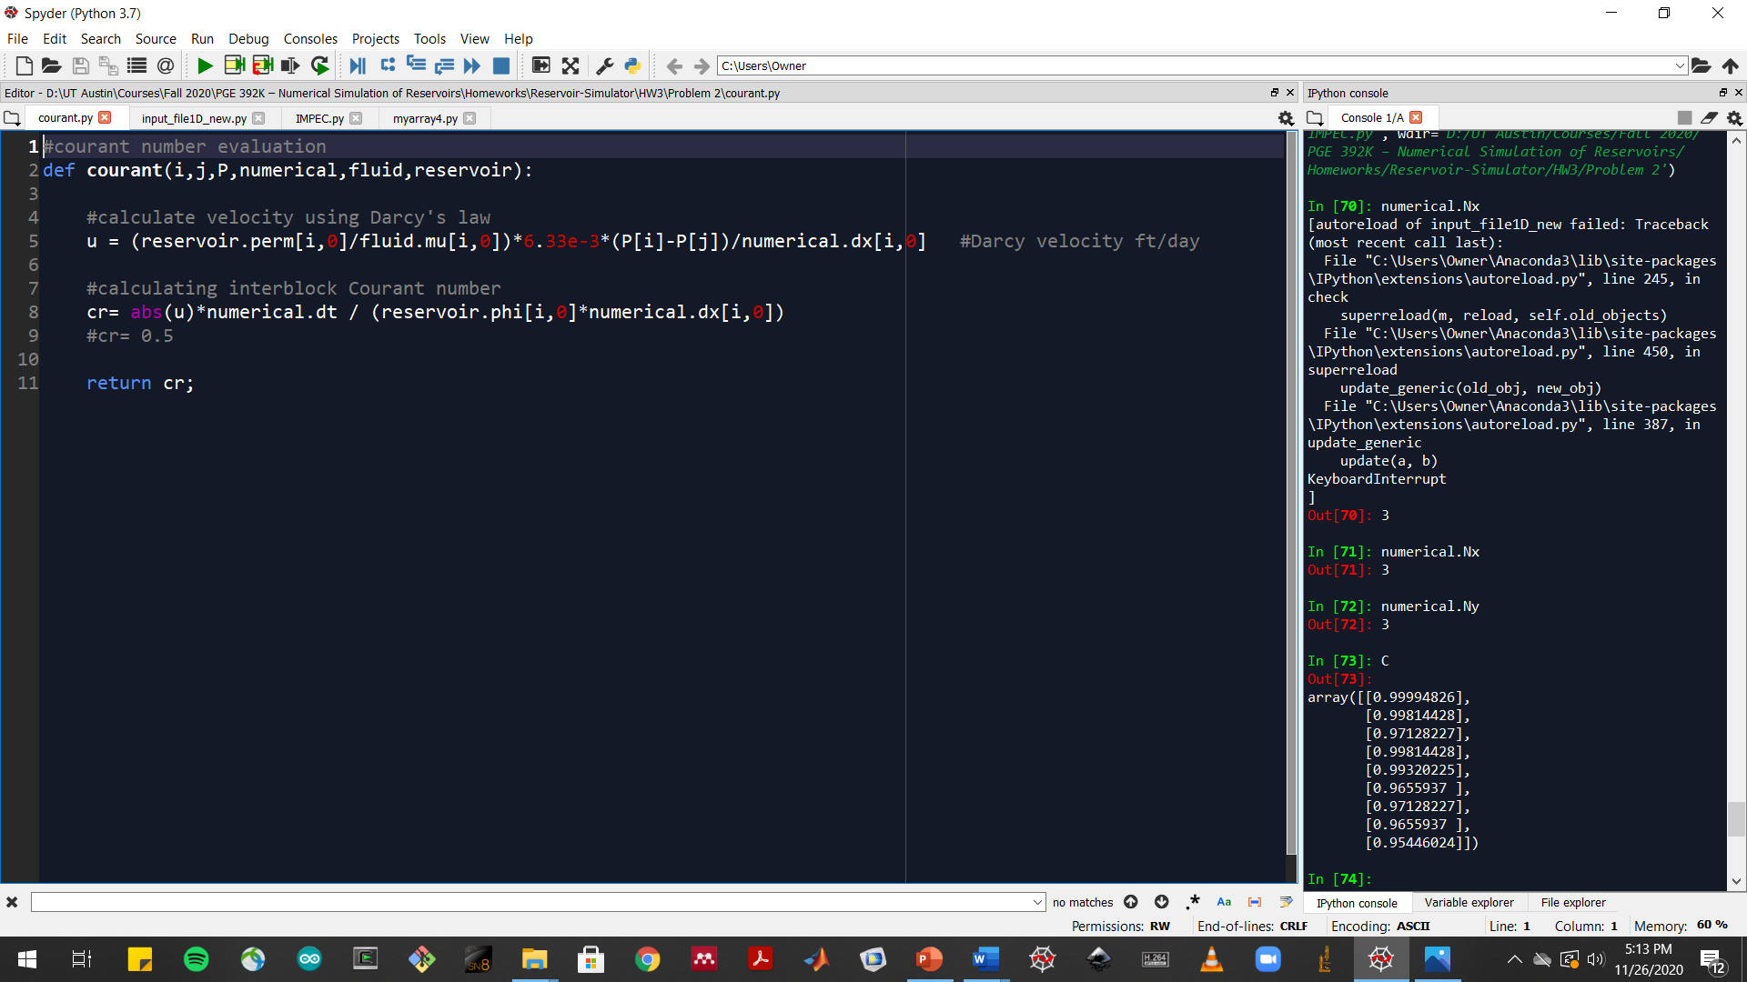
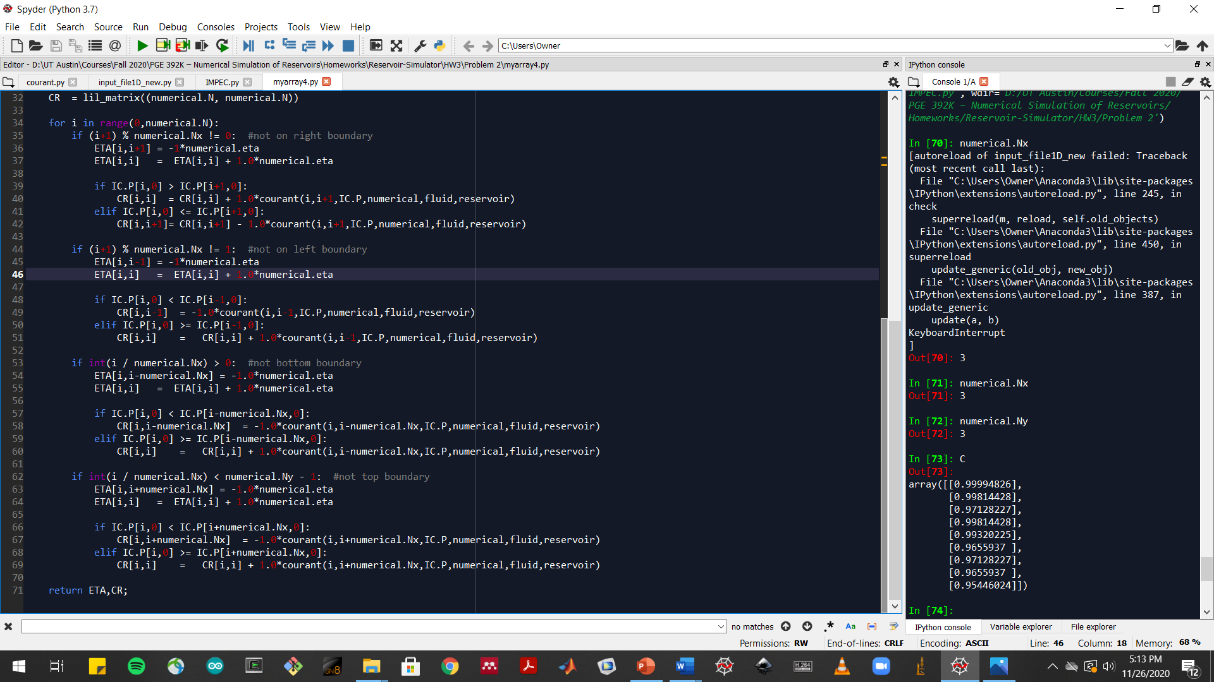
Problem 1.d Snapshot(s) of the code

Slide 11
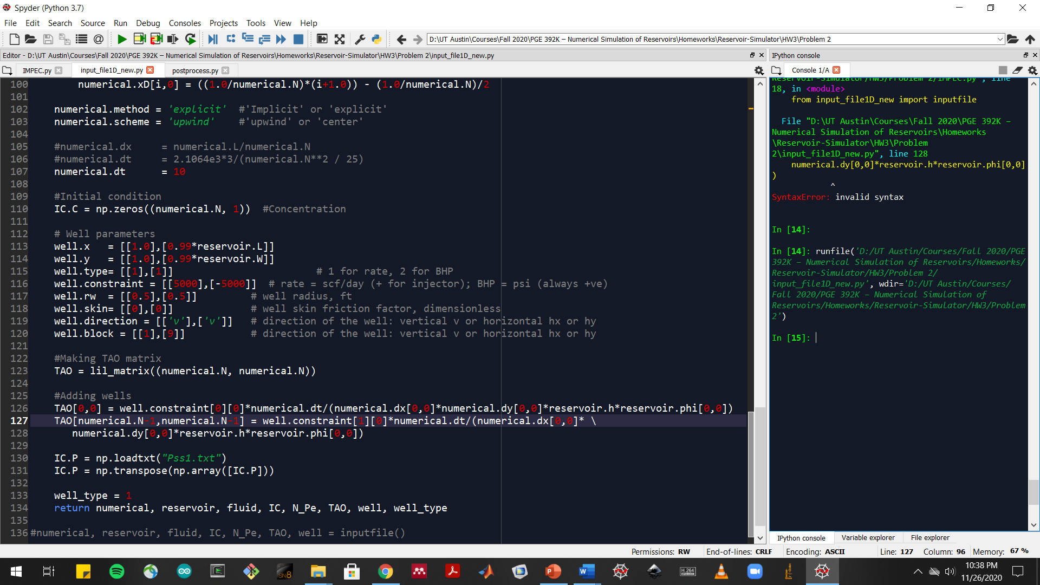
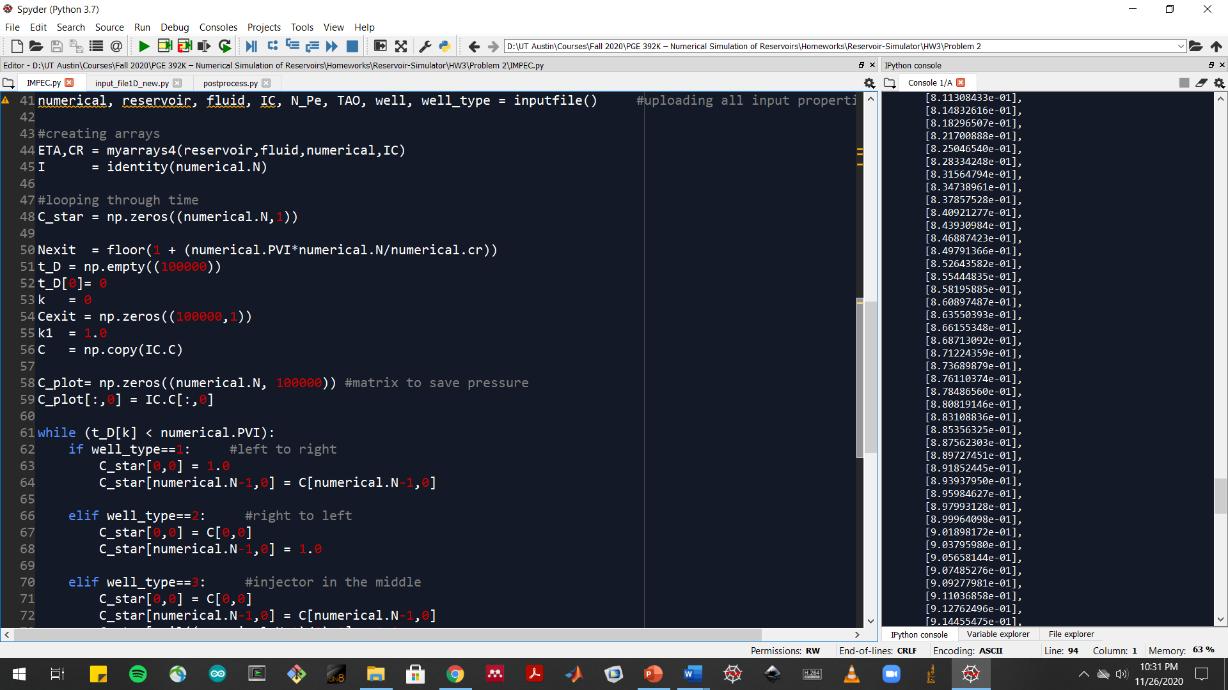
Problem 1.e Snapshot(s) of the code

Slide 12
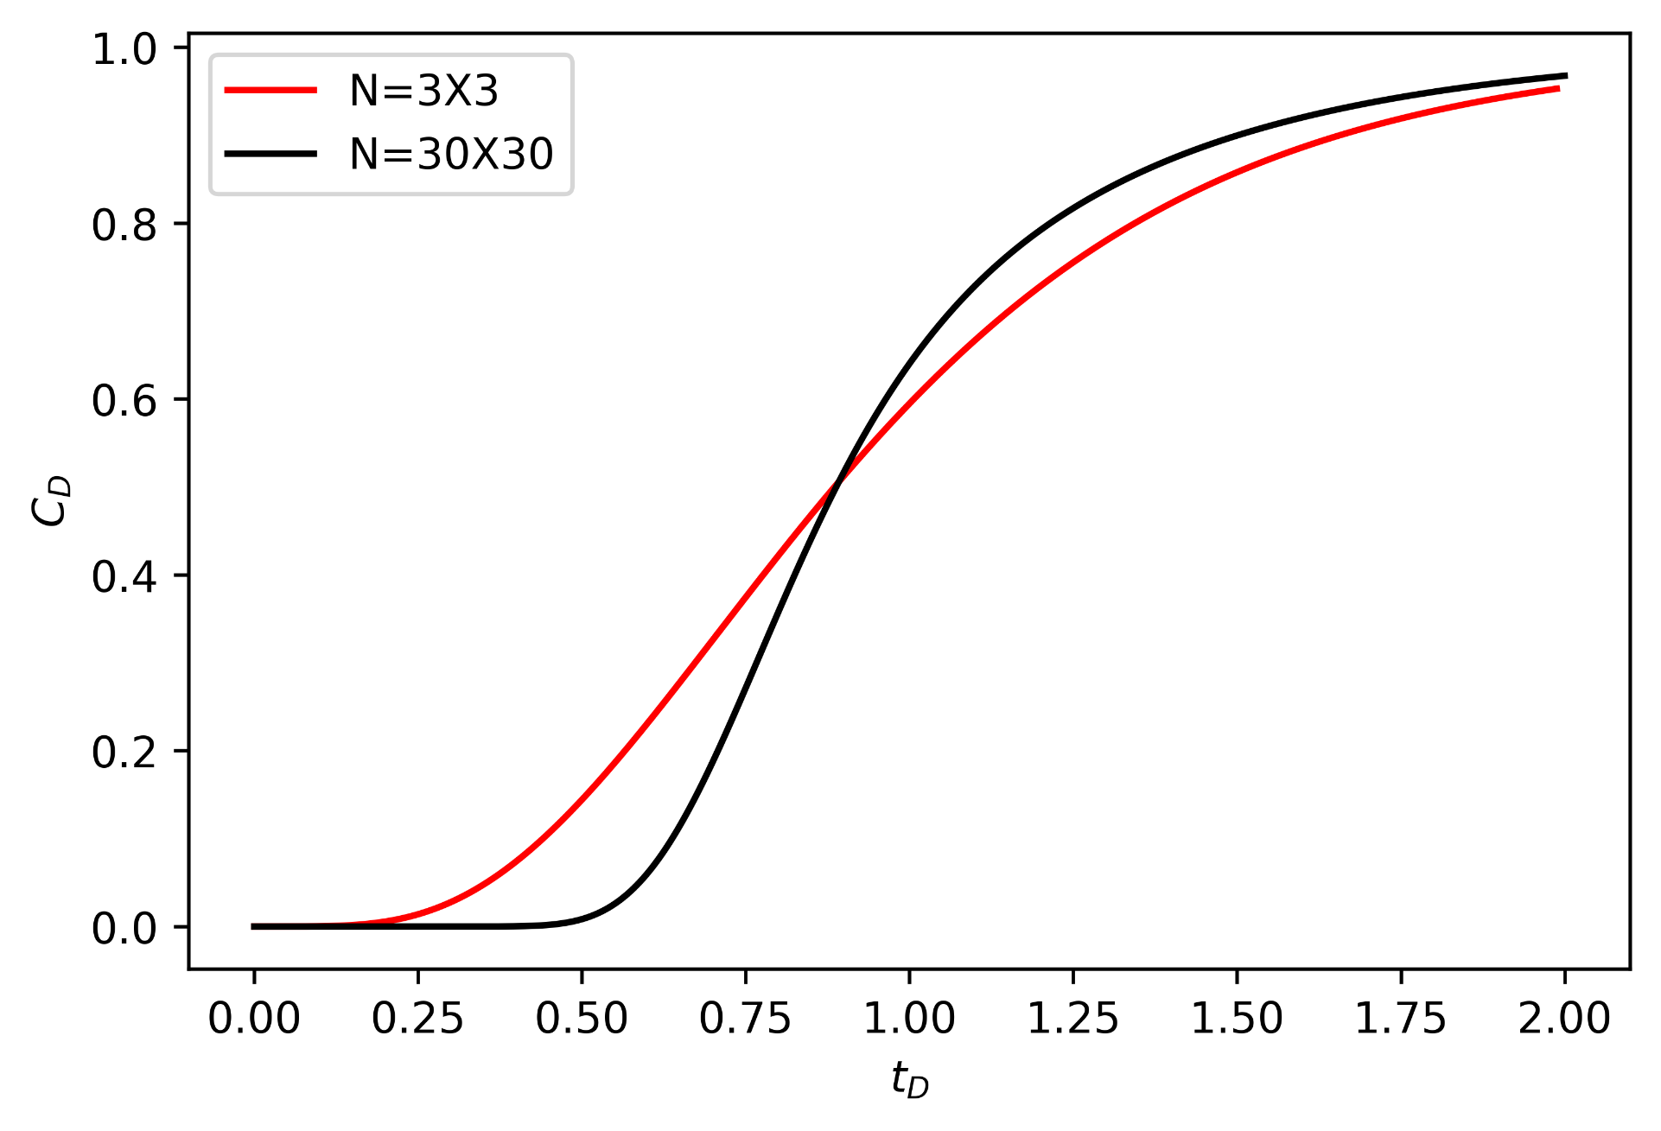
Problem 1.e Effluent Concentration Plot (3*3 and 30*30 on the same plot)

Slide 13
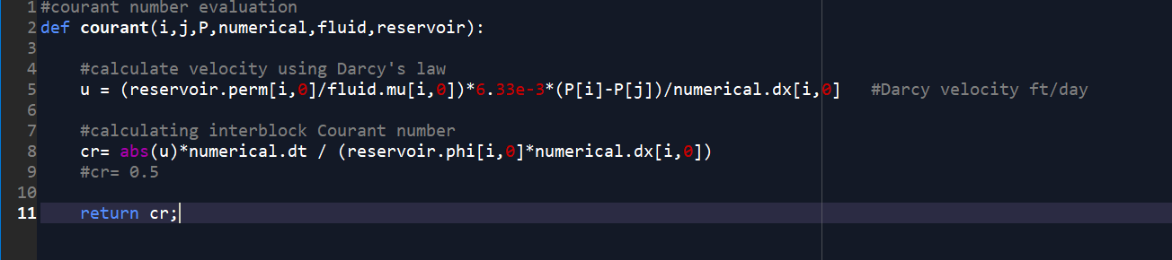
Problem 2.a Snapshot(s) of the code

Slide 14
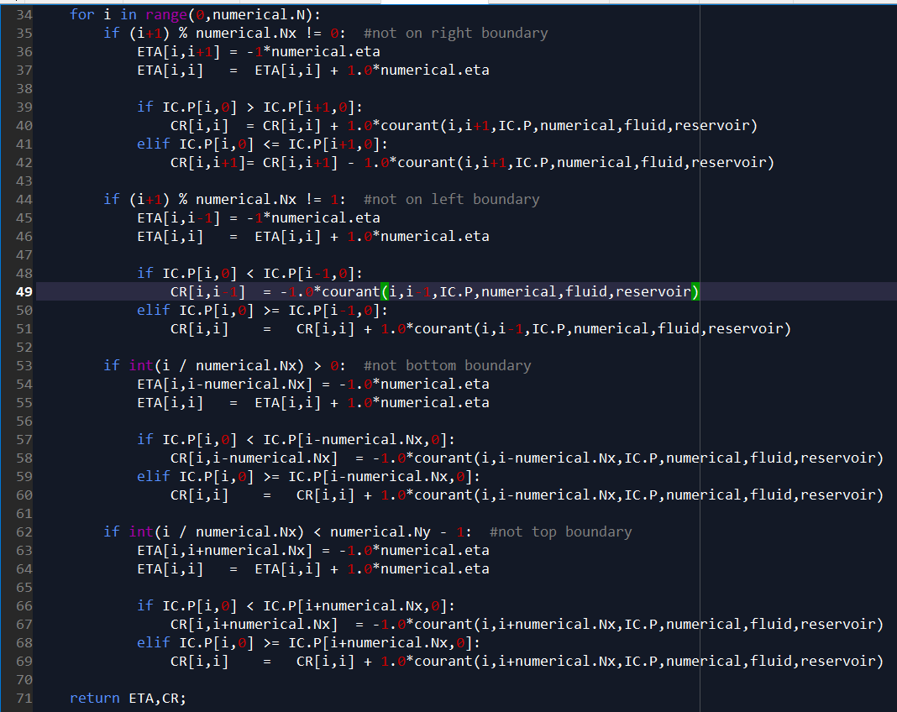
Problem 2.b Snapshot(s) of the code

Slide 15
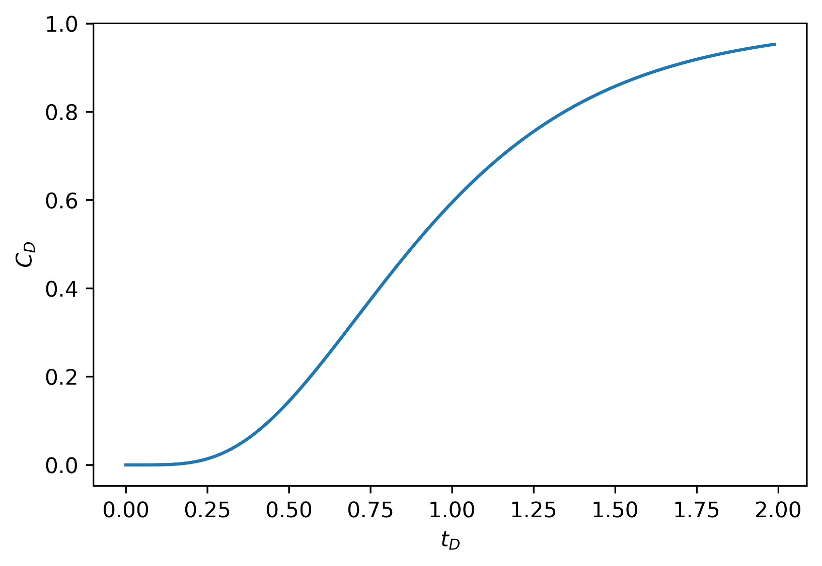
Problem 2.c Plot

Slide 16
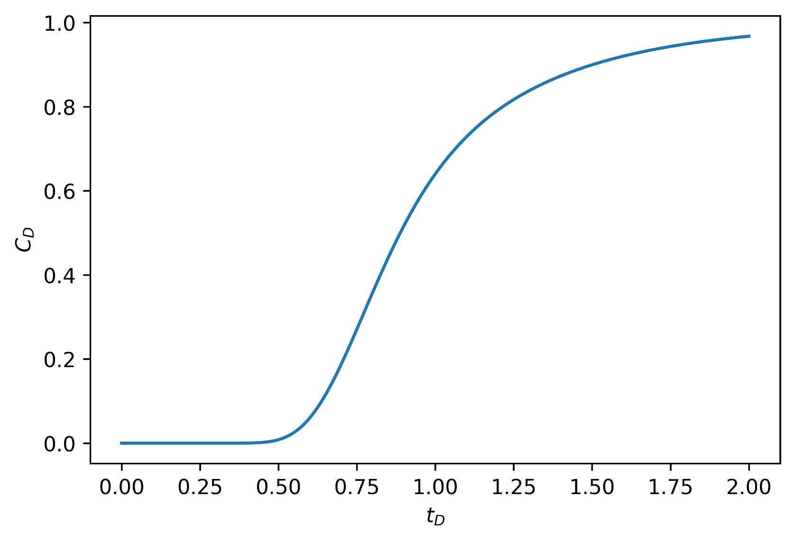
Problem 2.d Effluent Concentration Plot

Slide 17
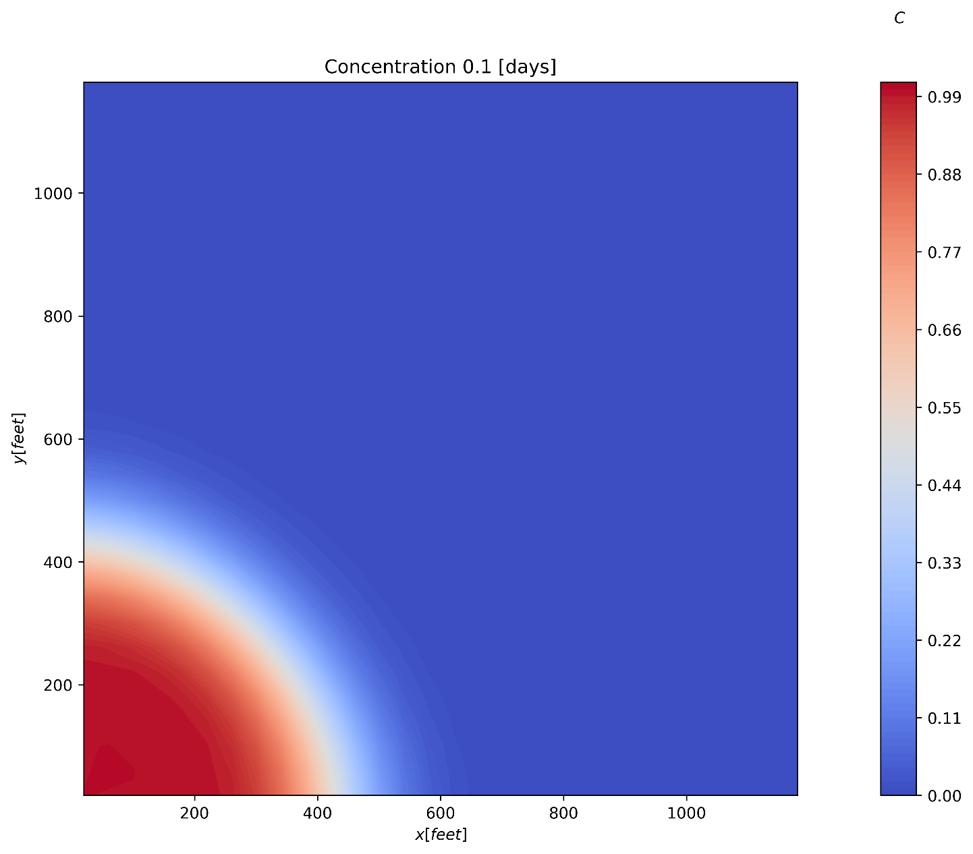
Problem 2.d Concentration field at tD=0.1

Slide 18
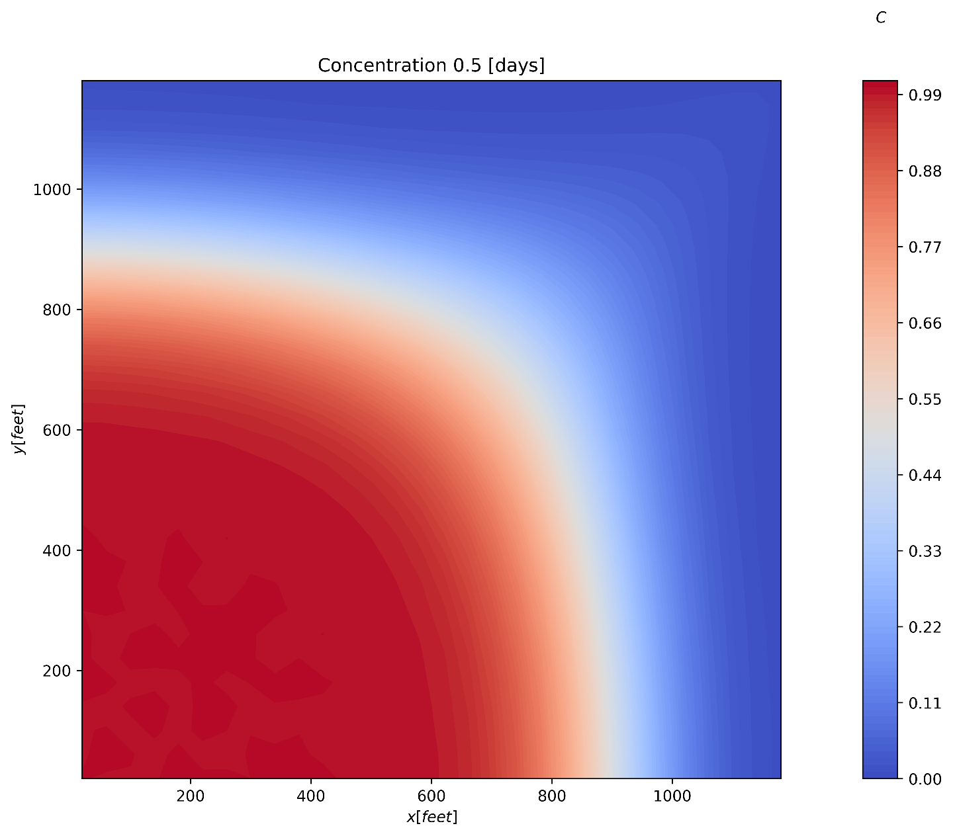
Problem 2.d Concentration field at tD=0.5

Slide 19
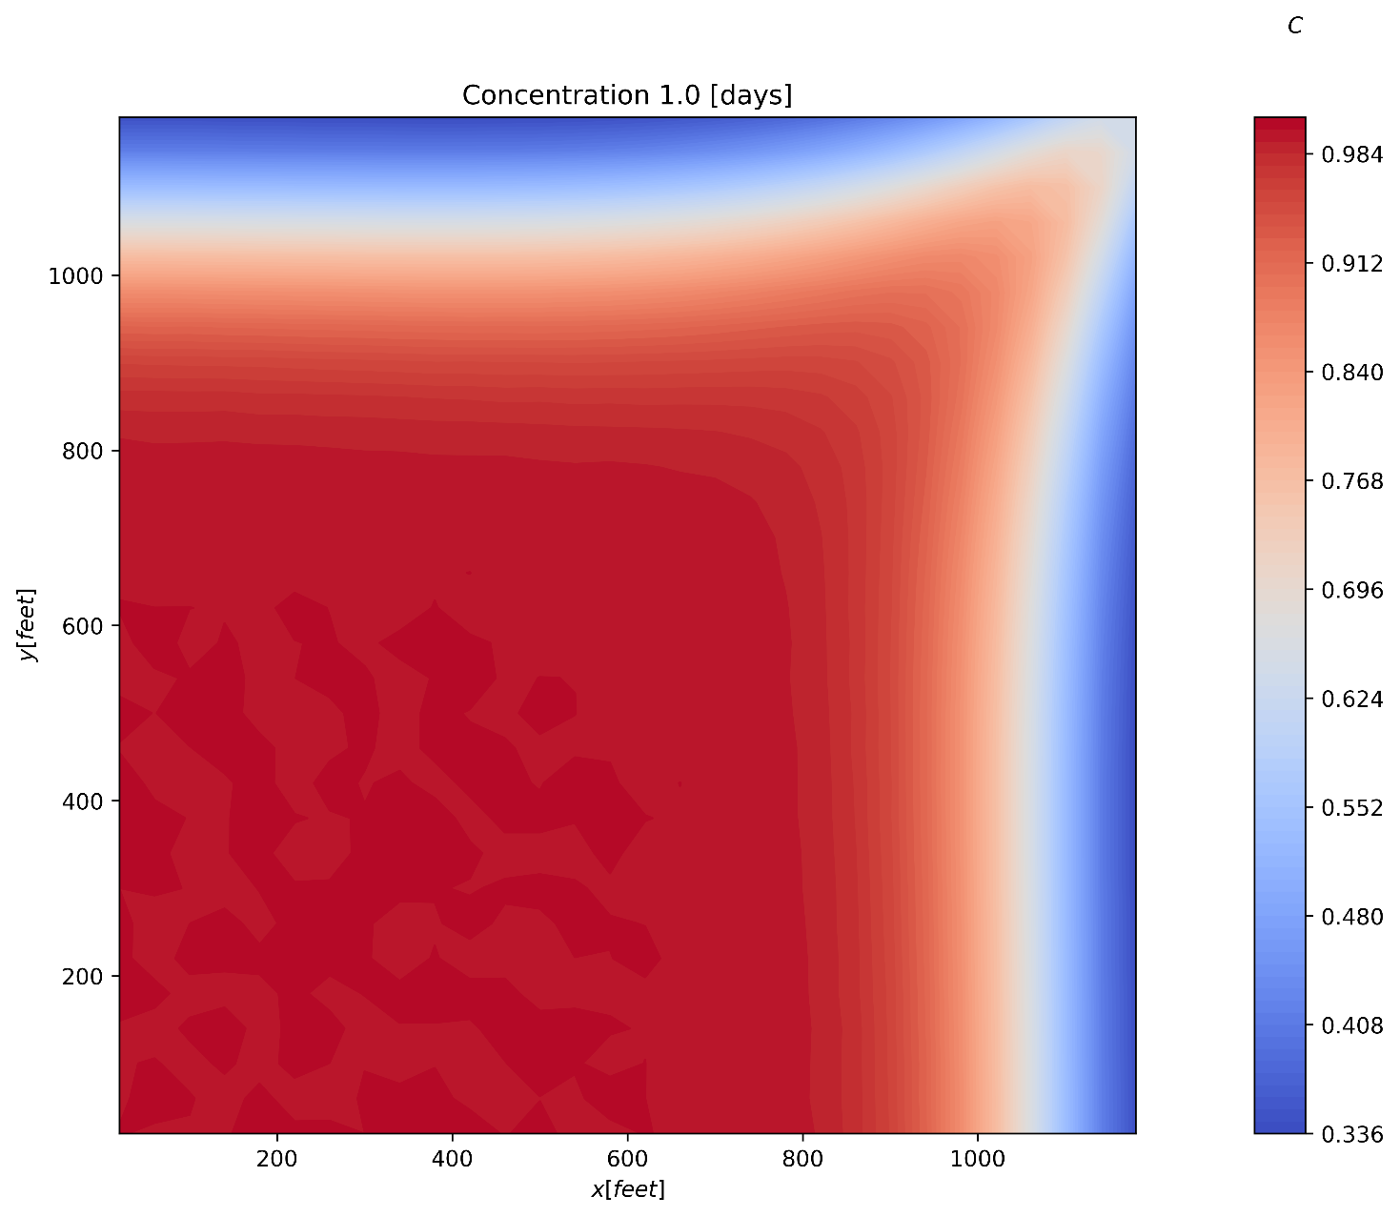
Problem 2.d Concentration field at tD=1.0

Slide 20
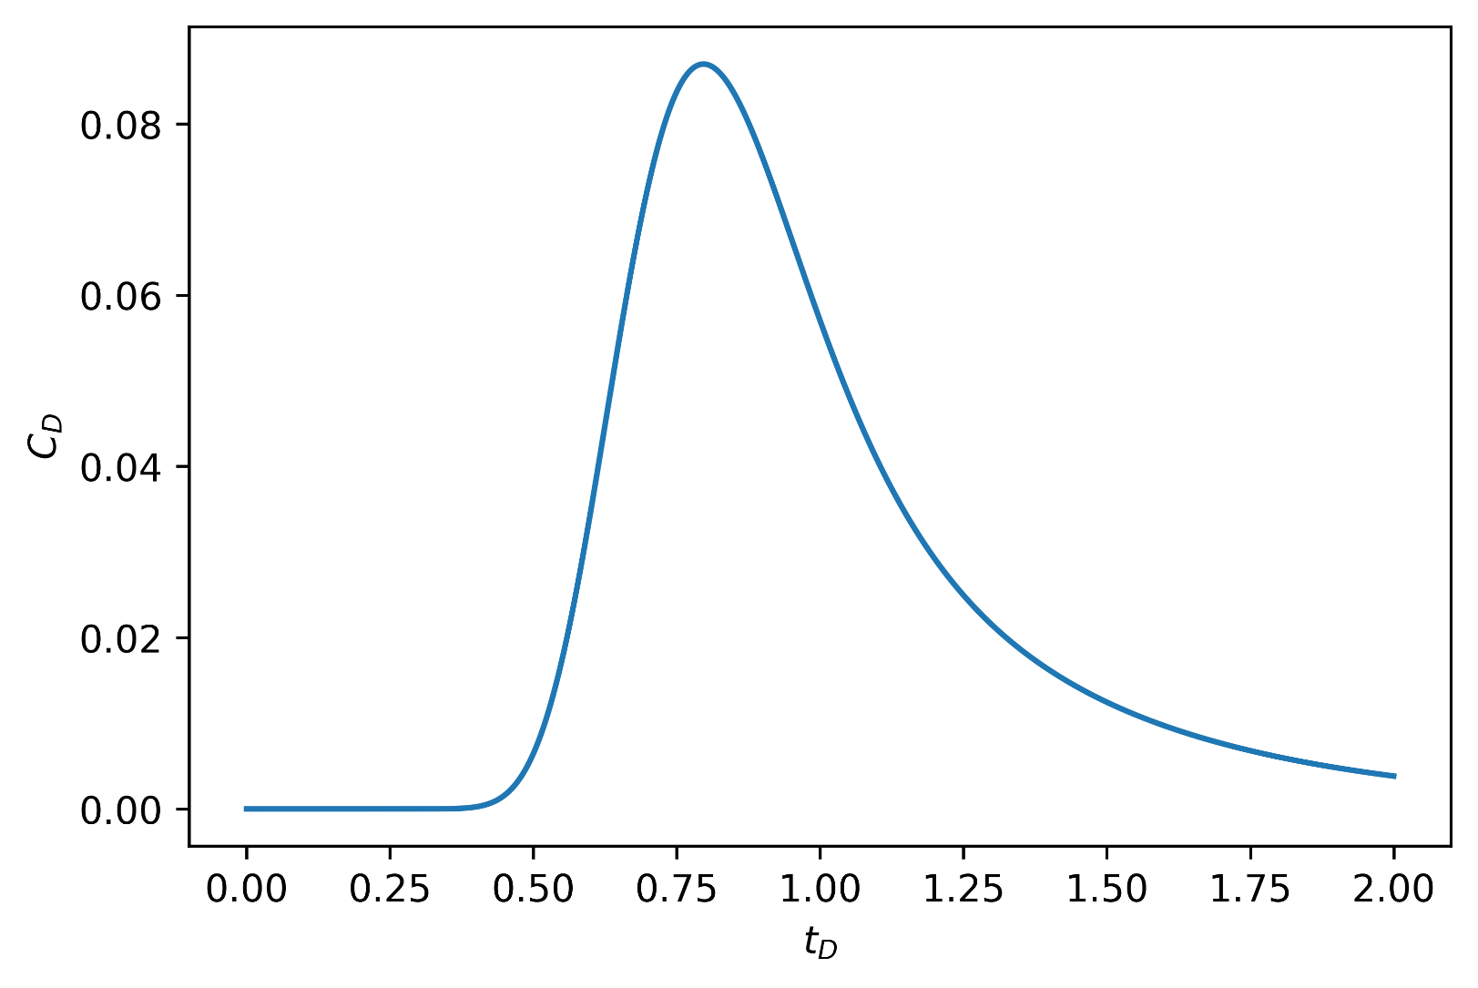
Problem 2.e Effluent Concentration Plot

Slide 21
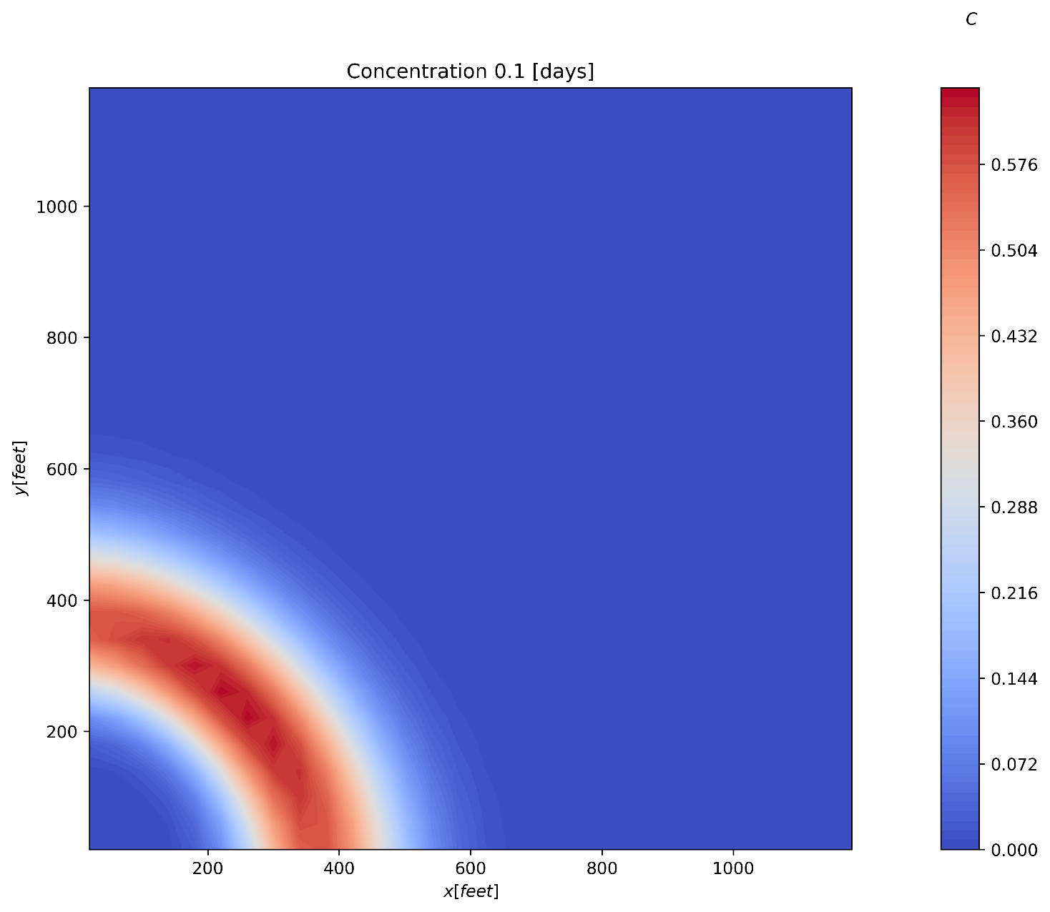
Problem 2.e Concentration field at tD=0.1

Slide 22
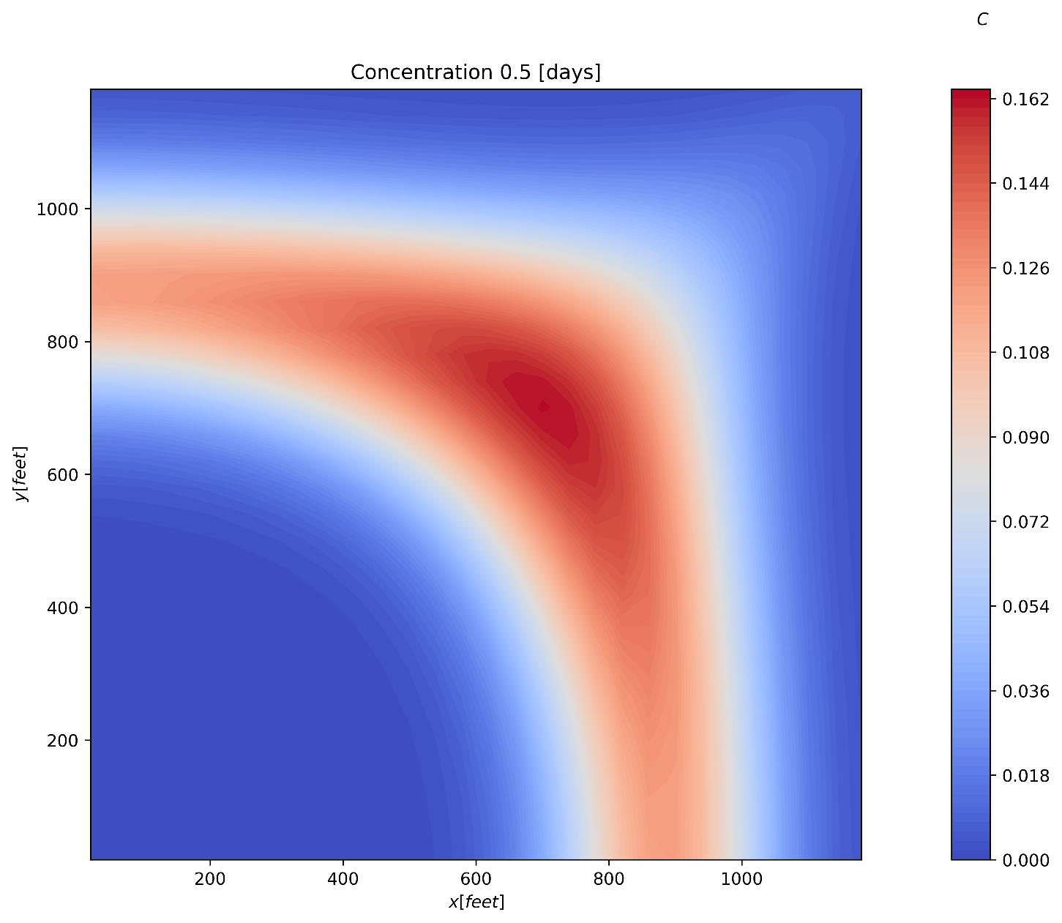
Problem 2.e Concentration field at tD=0.5

Slide 23
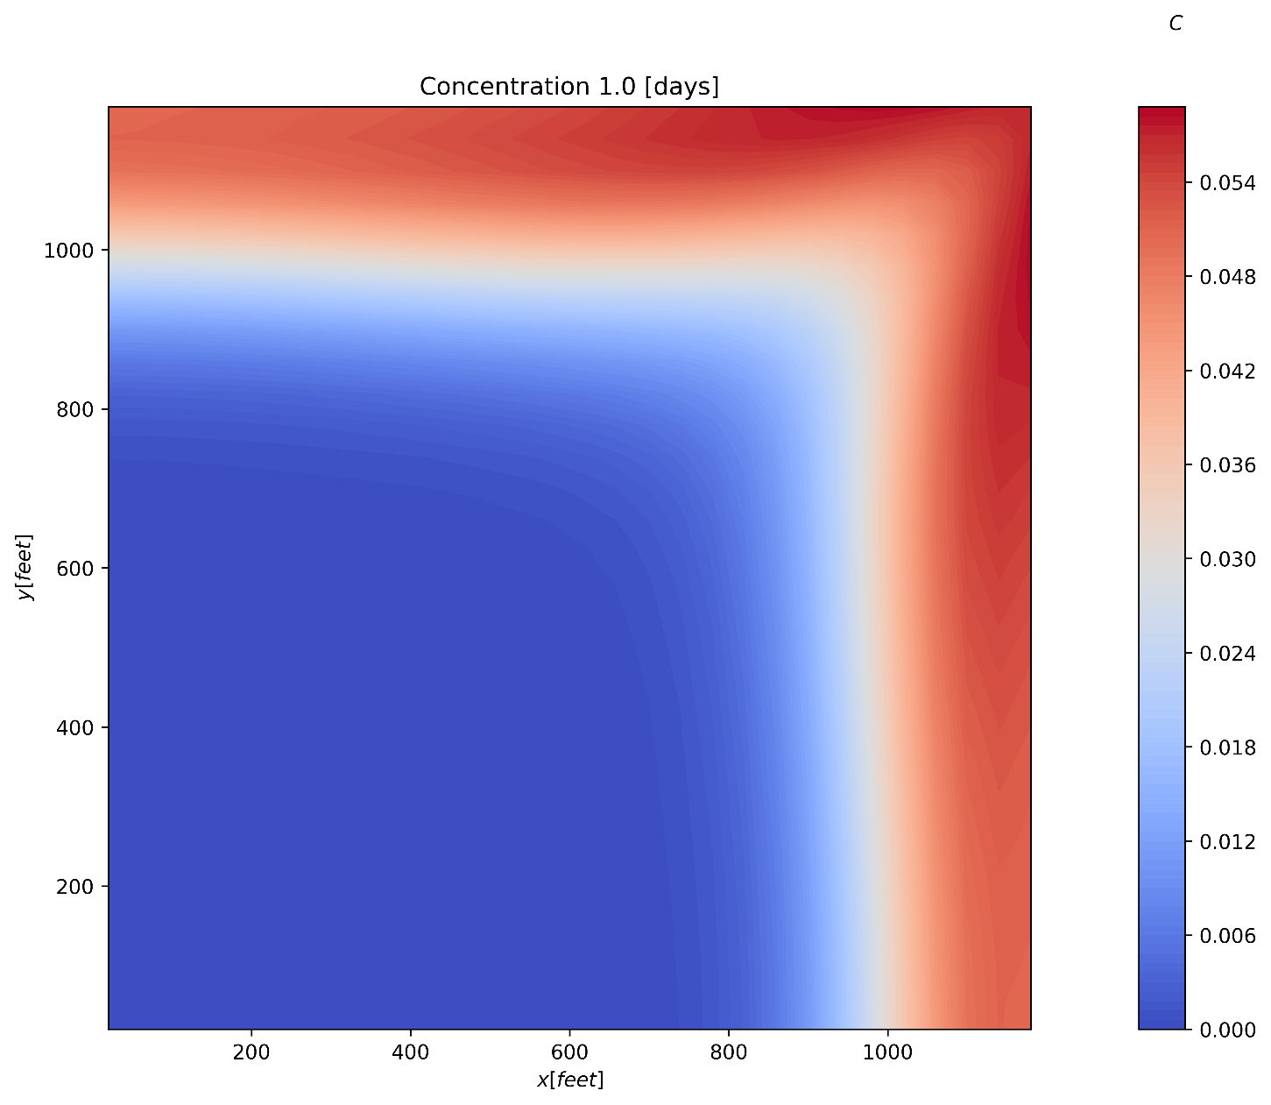
Problem 2.e Concentration field at tD=1.0

